Slide 1


Identification of a Drinking Water Softening Model using Machine Learning
Jake Jenden
Internship supervisor: Erwin Visser, MSc
University of Twente supervisor: Prof. Dr. H. Zwart
Study: MSc Systems and Control
6 January 2020
Jake Jenden

Slide 2
Aim of Research
Identify a drinking water softening model using Machine Learning (ML)
Jake Jenden

Slide 3
Research Questions
Is it possible to develop a model of the softening treatment process of a Water Treatment Plant using ML?
Is the data provided for this research adequate to develop a model using ML?
Jake Jenden

Slide 4
Table of contents
Background Information about the Softening Process
Data Pre-Processing and Data Analysis
Machine Learning (ML)
Neural Network (NN)
eXtreme Gradient Boost (XGBoost)
Methods
ML Results
Results Discussion and Conclusions
Jake Jenden

Slide 5
Background Information

Slide 6
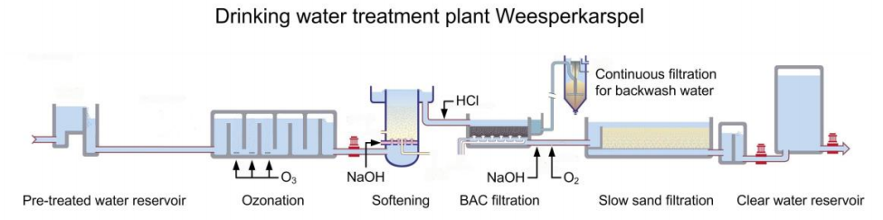
Drinking Water Treatment Plant (WTP)
Step 1:
Ozonation is carried out on the pre-treated water for disinfection of micro pollutants
Step 2:
Softening reactors are used to reduce the hardness of the water
Step 3:
Biological Activated Carbon (BAC) filters are used to remove organic matter and organic micro pollutants
Step 4:
A slow sand filter removes suspended solids
Step 5:
The resulting water is stored in a clear water reservoir ready for distribution
Jake Jenden

Slide 7
Definition and Problems of Hard Water
Hardness is measured by adding the concentration of calcium and magnesium ions in water
More lead and copper is dissolved in the distributed water
A higher detergent dosage for washing is required for harder water
Scale buildup in heating equipment and appliances
Hard water tastes worse than soft water
Jake Jenden
Notes:
Ingestion of large quantities of copper and lead has negative effects on the public’s health
Higher household costs
Increase in energy consumption
Equipment defects

Slide 8
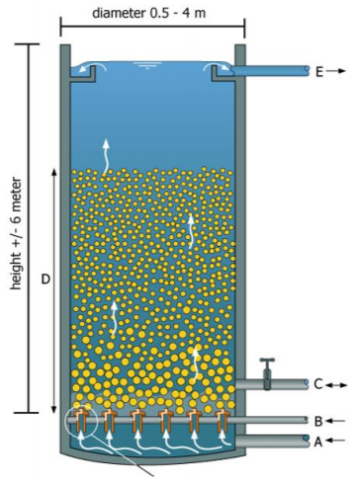
Pellet Softening Reactor
Calcium carbonate crystallisation on the seeding material leads to a variation of pellet sizes
Dosing heads in the circular plate, allow the water to pass through
Caustic soda is fed into the reactor via the pipe labeled B
Draining of the pellets occurs via tap C
Figure 1: Softening pellet reactor (L. Rietveld, 2015)
Jake Jenden
Notes:
Water is pumped in an upward direction
Reactor is filled with seeding material
Heavier larger pellets sink to a lower height in the reactor
Lighter smaller pellets float higher in the reactor
Facilitates the calcium carbonate crystallisation reaction
An increase in pellet diameters leads to an increase pressure difference
Once a particular pressure difference threshold is exceeded, the draining action is instigated

Slide 9
Data Pre-Processing

Slide 10
Corrupted Data
Dataset contains erroneous values, such as duplicated or missing values
Often encoded as blanks, NaNs, null-values or other placeholders
Erroneous values in the dataset reduces the performance of ML algorithms
Often erroneous values in time series datasets
Sensors for time series readings are often temporarily switched-off, damaged or blocked
Therefore, missing values arise in the time series dataset
Jake Jenden

Slide 11
Removing Corrupted Data Techniques
Remove the rows containing erroneous values
Con: ML models learn from data with missing time steps
Interpolation of erroneous values
Interpolation means estimating data values based on known sequential-data
Set the missing values to a constant number, e.g. 0 or a large negative value
Idea is that the ML algorithm ignores the irregular values when training the model
The method adopted to tackle corrupted data, depends on the dataset
Jake Jenden

Slide 12
Machine Learning (ML)

Slide 13
Definition of Machine Learning (ML)
Informal definition:
Machine Learning (ML) is the science of programming computers using algorithms, so they can learn from data
Formal definition:
A computer program is said to learn from experience E with respect to some task T and some performance measure P, if its performance on T, as measured by P, improves with experience E
Jake Jenden

Slide 14
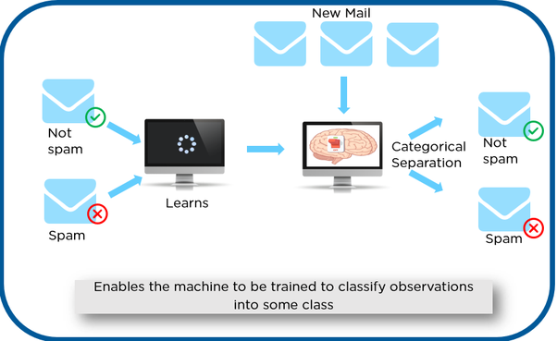
Supervised Learning
Feed the ML algorithm with input-output training data pairs
ML algorithm generates a function (model) that maps the input to the output, i.e. Y=f(X)
Unsupervised learning is when the training data does not include an output to learn from
This research focusses only on supervised learning
Figure 2: Supervised learning example (A. Géron, 2017)
Jake Jenden

Slide 15
ML Data Partitions and Hyperparameters
A hyperparameter is a parameter of a learning algorithm and external to the model
A dataset is often for ML partitioned into: train, validation and test datasets
Train partition is used for training during the implementation of the ML algorithm
Validation partition is used to evaluate the model during training
Allows you to effectively tune the hyperparameters
Test partition consists of data used to determine the final performance of the created model
Jake Jenden

Slide 16
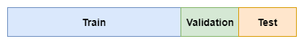
Train-Validation-Test Data Split
Most often data splitting method used in ML
Train-validation-test data split, splits the whole dataset into train, validation and test partitions
A data split of 80% train data and 20% test data is often selected as a starting point
A validation partition is not considered always necessary
Jake Jenden

Slide 17
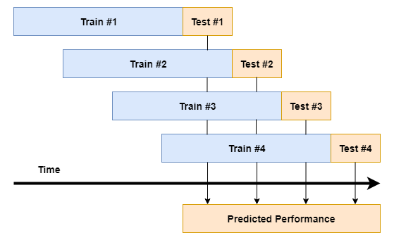
Walk-Forward Data Split
Originally designed by the financial trading industry
Data is split into windows
A model is generated for each set of windowed data
Helps to validate whether the hyperparameters need to be adjusted to improve performance during training
Jake Jenden
Notes:
These days, often applied on time series datasets
Each window has the same train-test data split
Following window is the same length and shifted in time by the length of the test set

Slide 18

Overfitting and Underfitting
Overfitting happens when a ML model fits the train dataset too closely
Consequently, the random fluctuates in the training set are learnt as concepts in the model
Therefore, not as effective at dealing with new data
Underfitting occurs when a ML model is unable to fit the training data nor new data (i.e. test dataset)
Figure 3: Overfitting example (A. Bhande, 2018)
Jake Jenden

Slide 19
Neural Networks (NNs)

Slide 20
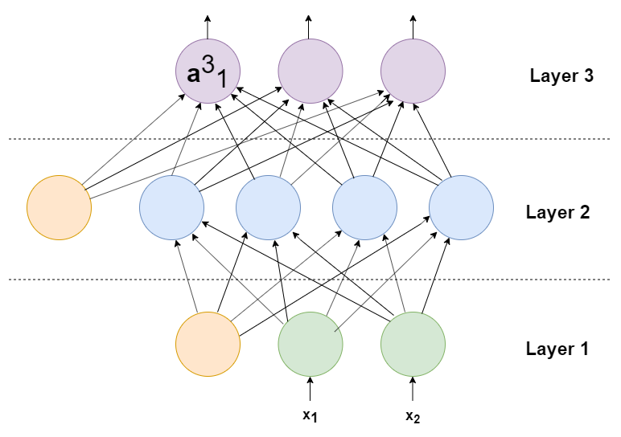
Neural Networks (NNs) Introduction
Neural Networks (NNs) consist of layers of neurons with weights interlinking them
An example of a feedforward network, since connections are in a forward direction
Bias neurons are not dependent on previous layers
Key: Green circles = input neurons, orange circles = bias neurons, blue circles = hidden neurons
Jake Jenden

Slide 21
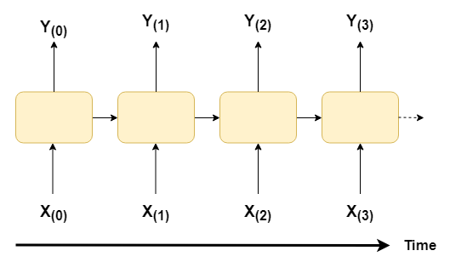
Recurrent Neural Networks (RNNs)
A recurrent Neural Network (RNN) is a more complex version of a neural network
Connections can also go in a backwards directions
Uses previous outputs to calculate the current output
Key: X=input, Y=output
Jake Jenden
Notes:
Line pointing to the next time step neuron represents the backwards direction

Slide 22
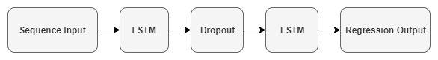
Standard Time Series RNN Structure
Layers in an RNN often include LSTM cells and dropout layers
Optimum structure varies for each dataset
Structure adopted for this research is shown below
Jake Jenden

Slide 23
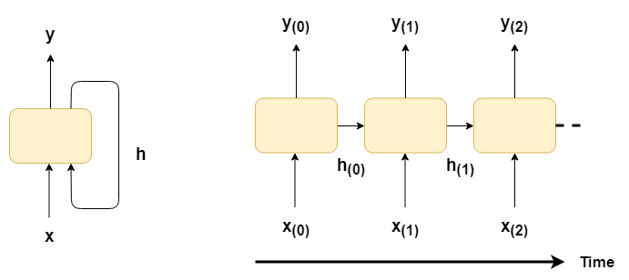
Long Short-Term Memory (LSTM) Cells
LSTM cells selectively save information from previous outputs based on an algorithm
Aim is to prevent the vanishing gradient problem
The stored previous outputs are used to determine the current output
Memory function used to calculate the output
Key: x=input, y=output, h=memory function
Jake Jenden

Slide 24
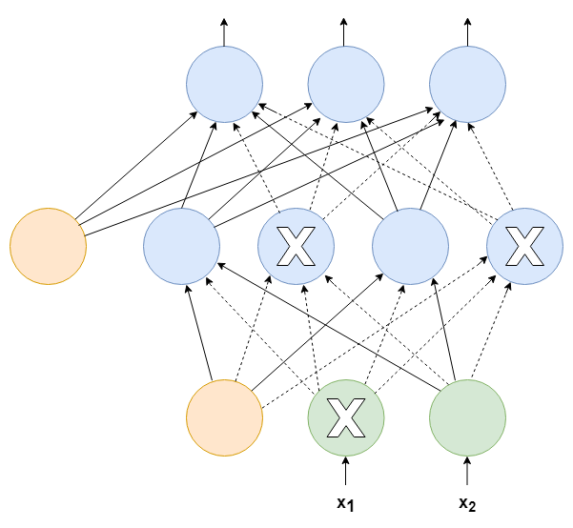
Dropout Layer
Aim of a dropout layer is to reduce overfitting
At every training step, every neuron has probability p (e.g. p=50%) of not being used
Reduces co-dependencies in the network
Key: Orange circles = bias neurons, blue circles = hidden neurons, crosses = inactive neuron
Jake Jenden

Slide 25
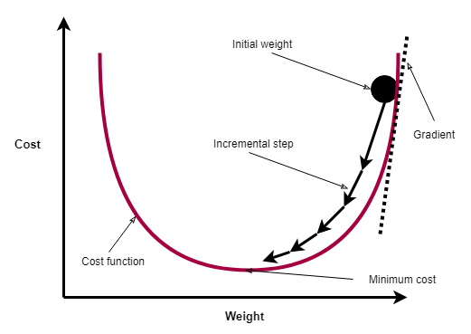
Gradient Descent
Gradient descent is an algorithm used to update the weights (parameters) in a NN
An iterative optimisation algorithm
A cost function is a measure of error between the actual data points and the prediction
Gradient is used to find the optimum point (optimum set of weights) that reduces the cost function
Jake Jenden

Slide 26
eXtreme Gradient Boost (XGBoost)

Slide 27
Introduction to Decision Trees
Definition of a decision tree (M. Rouse, 2012):
A decision tree is a graph that uses a branching method to illustrate every possible outcome of a decision
Decisions are made using numeric ranges and if statements
Jake Jenden

Slide 28
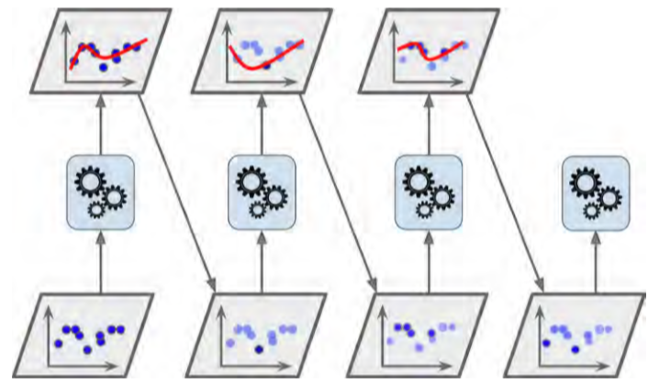
Introduction to XGBoost
eXtreme Gradient Boost (XGBoost) has won many prizes online
Algorithm was introduced in 2016 by T. Chen
An XGBoost model is a combination of decision tree models
The XGBoost model performs better than the best individual decision tree model
Figure 4: Continuous incorporation of new models (A. Géron, 2017)
Jake Jenden

Slide 29
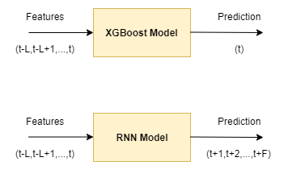
Model Prediction Horizons
Prediction time steps from the current time step to a certain future time step is called the horizon
XGBoost model does not make a prediction for future time steps
RNN has a horizon with future time steps
Key: F= forecast length, L=number of previous time steps
Jake Jenden

Slide 30
Methods

Slide 31
Identification of Inputs and Outputs
pH is chosen as output of model
pH has good properties for control
Based on insight into the water softening treatment system, the following inputs are chosen:
Caustic soda flow [m^3/h]
Bottom Pressure [kPa] – pressure at bottom of reactor
Pellet-bed pressure [kPa] – pressure difference across pellet-bed
Bed Height [cm] – height of the pellet-bed
Draining [-]
Seeding [-]
Jake Jenden

Slide 32
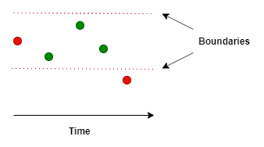
Data Collection
Interpolation is applied to the data between the recorded values by the water company
A data interval of one minute is selected
Provides satisfactory retention of data
Low computation times
Key: Red dot= recorded value, green dot= not recorded
Jake Jenden

Slide 33
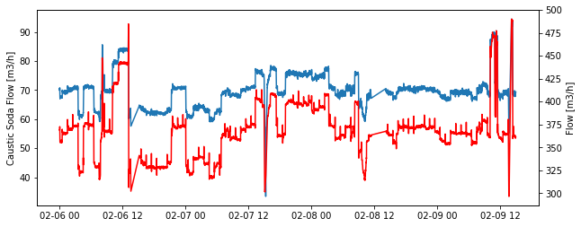
Data Pre-Processing: Data Removal
Flow rate is largely dependent on the caustic flow rate
Corrupted data rows are removed from the dataset
Retention of about two thirds of the dataset
Key: Red plot= water flow rate, blue plot= caustic soda flow rate
Jake Jenden

Slide 34
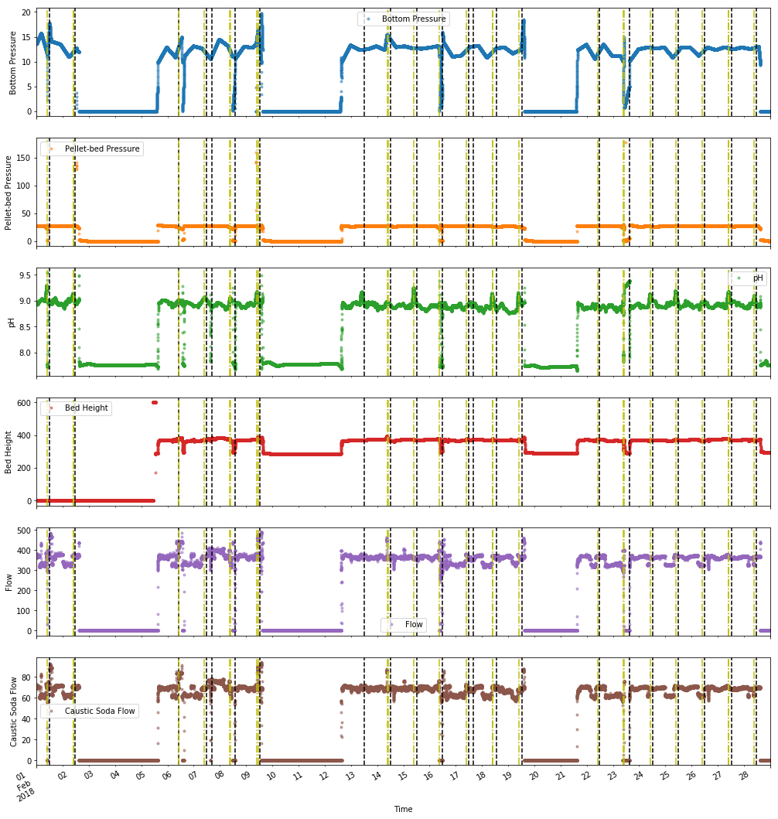
Jake Jenden

Slide 35
Data Pre-Processing: Data Splitting
Only 10% test data considered necessary, due to many data samples
RNN train-validation-test model applies a 30% validation partition
Monitor the performance of the algorithm during training
RNN train-validation-test model takes longer to run in general
MSE and R-squared are selected as the evaluation metrics
MSE is a measure of error
R-squared value measures the fit
Data Splitting Method | XGBoost | RNN
Walk-Forward | 90% train, 10% test | 90% train, 10% test
Train-Validation-Test | 90% train, 10% test | 65% train, 30% validation, 5% test
Jake Jenden

Slide 36
Prediction
Python code created by A. Sadad is adapted and used for ML implementation
TensorFlow is used as backend
Keras is used as frontend
RNN training is applied using the forecast lengths: F=1[min], 4[hr] and 24[hr]
Tests the limits of the RNN algorithm
XGBoost is not able to forecast
Jake Jenden
Notes:
TensorFlow use mathematical symbols to calculate the differential
Keras is UI package in Python that makes use of TensorFlow

Slide 37
Machine Learning (ML) Results

Slide 38
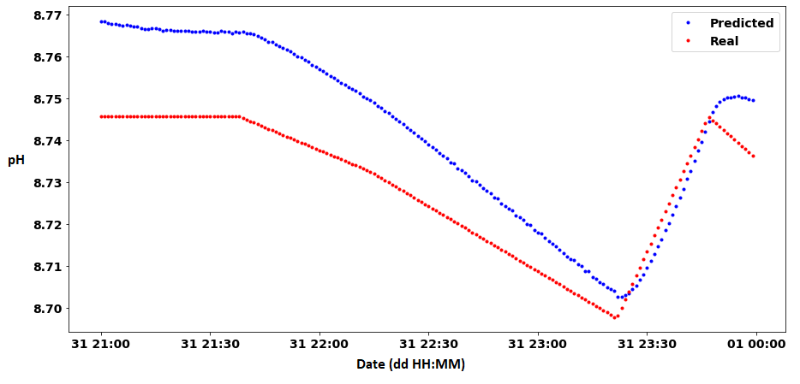
Train-Validation-Test RNN (with F=1[min]) Results
MSE is equal to 0.0004
Relatively low
R-squared is equal to 0.9007
Good fit
Slight lag in prediction
Heavily dependent on the previous pH value
Not a great prediction
Key: Red dot= actual data point, blue dot= predicted data point
Jake Jenden

Slide 39
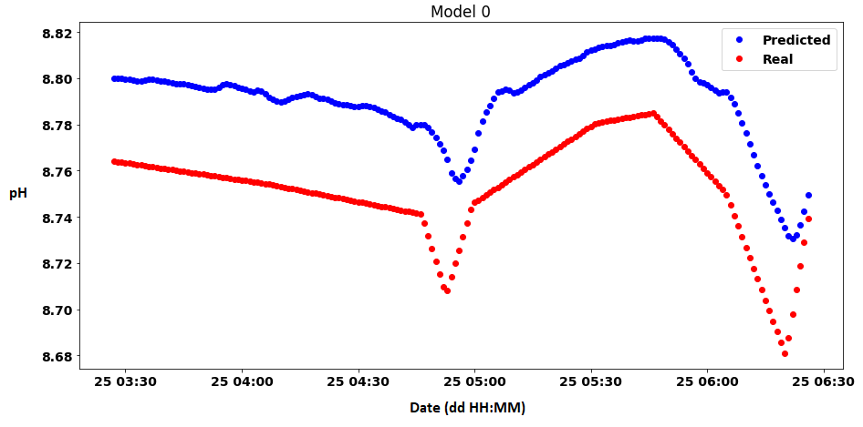
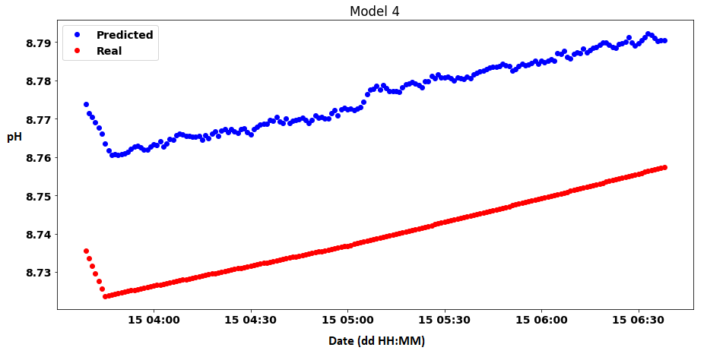
Walk-Forward RNN (with F=1[min]) Results
Two models displayed from the total six
Model 0 has an MSE of 0.0013 and an R-squared value of 0.6373
Model 4 has an MSE of 0.0017 and an R-squared of 0.3
Slight lag in prediction
Heavily dependent on previous pH value
Not a great prediction
Jake Jenden

Slide 40
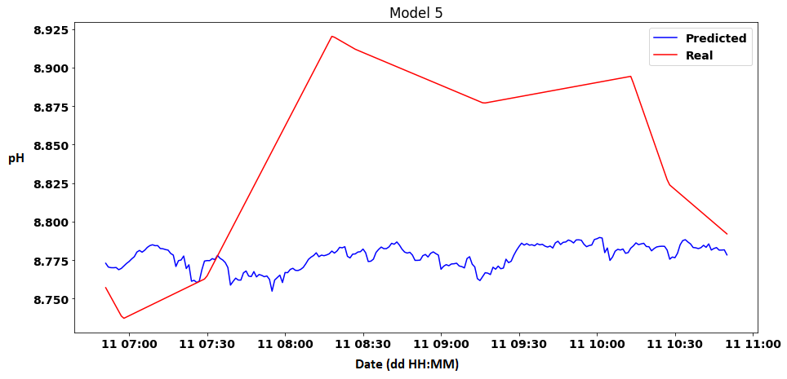
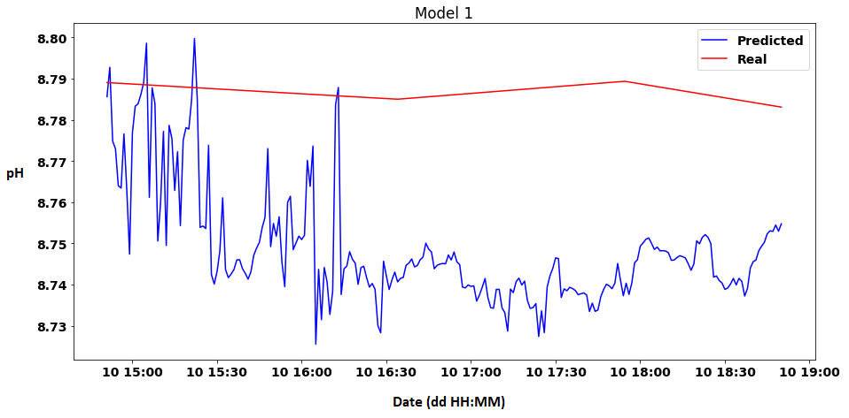
Walk-Forward RNN (with F=4[hr]) Results
Two models displayed from the total nine
Actual data has flatter profile than the prediction due to interpolation
Model 5 has an MSE of 0.0081 and an R-squared value of -1.5569
MSE is relatively low, but R-squared performs badly
Model 1 has an MSE of 0.0017 and an R-squared value of -801.8891
Jake Jenden

Slide 41
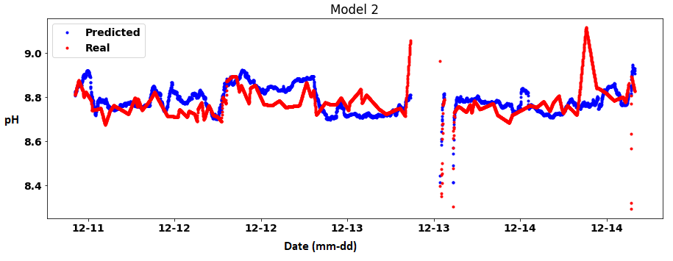
Walk-Forward XGBoost Results
One model displayed from the total seven
Model 2 has an MSE of 0.0049 and an R-squared value of -0.2389
Low MSE, but a poor R-squared value
Jake Jenden

Slide 42
Discussion
RNN models are not able to effectively predict the trend of the pH
Could be due to interpolation of the actual data
In general, all models have a relatively low MSE value
XGBoost models do not perform as well as the RNN models
XGBoost does not incorporate past pH values as a feature
Jake Jenden

Slide 43
Conclusions
Is it possible to develop a model of the softening treatment process of a WTP using Machine Learning (ML)?
It is possible to develop a model of the process with a relatively low MSE, but a poor R-squared value
Is the data provided for this research sufficient to develop a model using ML?
Data is insufficient, since it is interpolated and lacks the detail to identify a model with a good fit
Jake Jenden

Slide 44
Further Research
Gather more data to use in training of the ML algorithms
More trends to learn from, thus potentially a better performing model
Test the model on another reactor in the same Water Treatment Plant (WTP)
Validation of the model
Gather data that is not interpolated
Provides more information to create a better performing model
Use more inputs for generation of model
For instance, install a hardness sensor in the softening reactors
Jake Jenden

